Slide 1
The Differences of Li Bai and Du Fu's Poems in the 300 Poems of Tang Dynasty
Introduction to Probability and Statistics (1004)
1930026115 TANG Zhongyi 唐仲一
Conduct a hypothesis testing about poetry's length based on two samples of poetry
1930026017 CHEN Ziqi 陈子淇
Statistics and write results and discussions
1930026111 QIN Yuao 覃逾鳌
Write the material and method、conclusion about the report
1930026174 ZHENG Yuhan 郑宇涵
Processed the original data, writing programs to statistics the word frequency, and offered these data
1930026061 KONG Deran 孔德然
Write the abstract,title and introduction, put the pieces together
1930026143 XUE Shaojie 薛劭杰
Chi-square test to compare the image distribution of poetry

Slide 2
01
Introduction
02
Materials and Methods
CONTENTE
03
Result and Discussion
04
Conclusion
05
Reference

Slide 3
01
Introduction

Slide 4
Introduction
People all know that Chinese traditional culture is broad and profound, especially poetry culture. It uses simple rhyming sentences to describe countless scenes, moods, ideals and other things the poet wants to express, which lets people yearn. As a great poet, Li Bai and Du Fu represent the flourishing age of poetry in Tang Dynasty.
The project is to explore the differences between Li Bai's and Du Fu's Poems in "Three Hundred Tang Poems". We want to make full use of the statistical knowledge we have learned in this semester to study literature and poetry, and prove that statistics is useful in many aspects.
Background
Problem
Method
Theory
Hypothesis test, is a statistical inference method used to determine whether the differences between samples and samples, between samples and population are caused by sampling errors or essential differences.
Goodness of fit test is a statistical hypothesis test used to test the consistency between the number of observations and the theoretical number calculated according to a certain hypothesis or distribution model, so as to judge whether the hypothesis or model is consistent with the actual number of observations.
Our group applied descriptive statistics and statistical inference to complete our research. In order to verify the length difference between poems, we choose the t test of hypothesis test. And the method of goodness of fit test is used to judge image.

Slide 5
02
Materials and Methods
mainly from《 three hundred poems of tang dynasty》

Slide 6
Comparative experiment of poem length
Judgement standard：
Number of words in poems
Method:
Recording and calculating the average number of words and the variance of the number of words in 30 poems by li bai and du fu.
The double-sample hypothesis test method was used for data processing.
Under the condition of significance level α= 0.05.

Slide 7
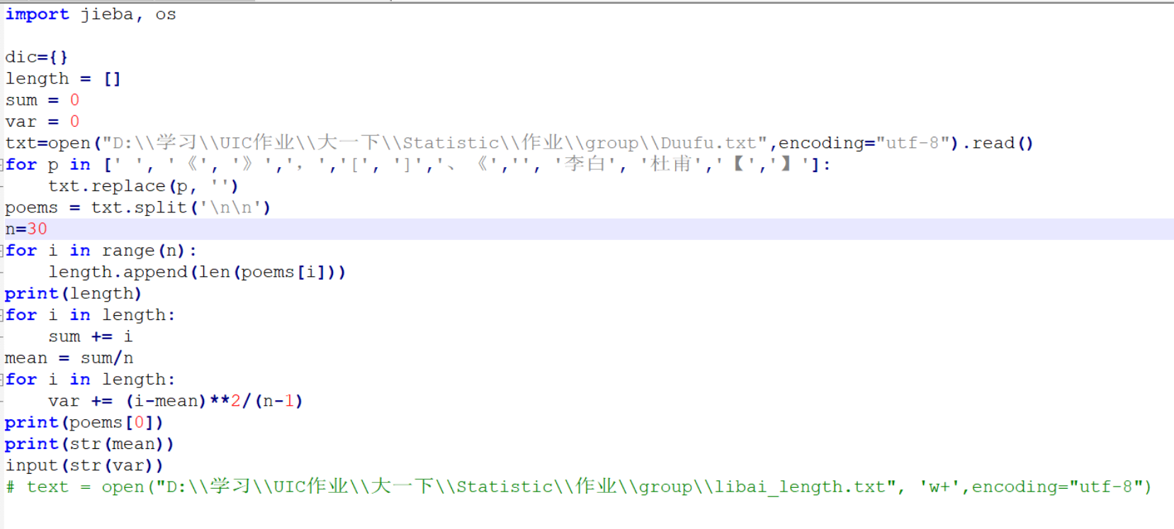
specific program:
counting the length

Slide 8
poetic images
data materials:
25 poems of li bai from 300 poems of tang dynasty as samples
all poems of du fu as the population
Method:
programmatically extract the images contained in the selected poems and calculate their word frequency.
classify into five types of images
Sample : the image word frequency of li bai
Population : image proportion of du fu
0.05 significance level
Chi-square Goodness of Fit tests

Slide 9
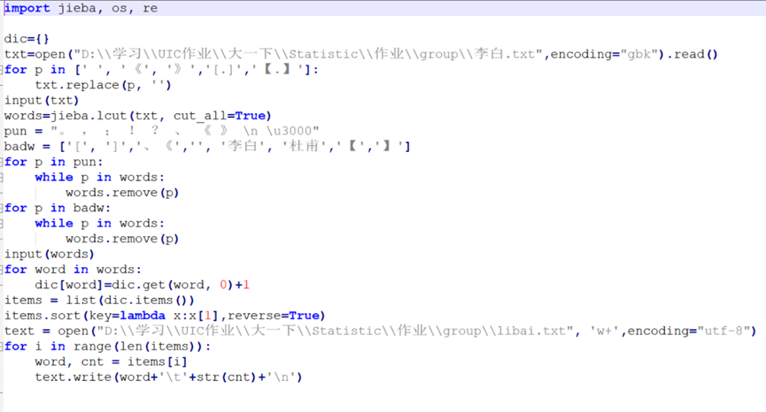
specific program:
Counting word frequency

Slide 10
03 Result and
Discussion

Slide 11
Result
In order to make inference statistics, Our team members used Hypothesis testing about two Population to study the difference between the lengths of Libai ’s poems and Dufu ’s poems in “Three Hundred Tang Poems” and Chi-square test. The distribution of image content in Dufu's poems.
Hypothesis testing about two Population
Chi-square Goodness of Fit Test

Slide 12
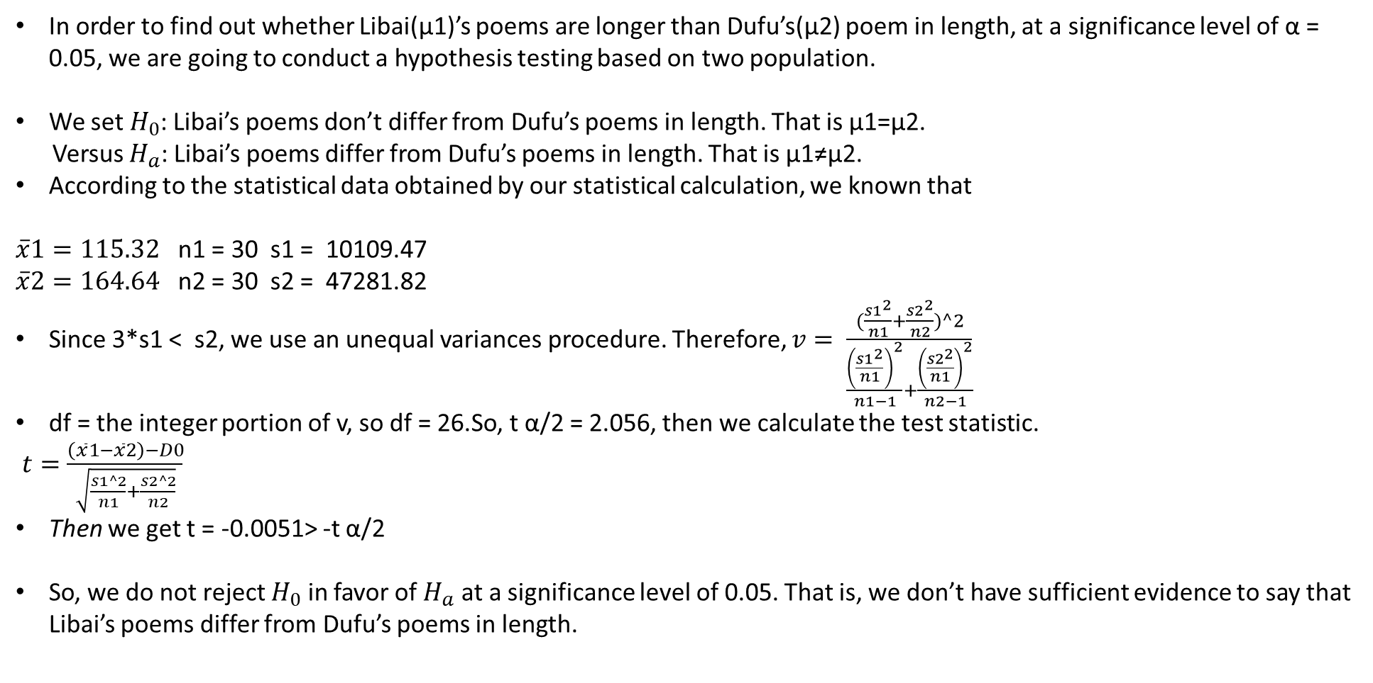
Result—Hypothesis testing about two Population
In order to find out whether Libai(μ1)’s poems are longer than Dufu’s(μ2) poem in length, at a significance level of α = 0.05, we are going to conduct a hypothesis testing based on two population.
We set $H_{0}$: Libai’s poems don’t differ from Dufu’s poems in length. That is μ1=μ2.
Versus $H_{a}$: Libai’s poems differ from Dufu’s poems in length. That is μ1≠μ2.
According to the statistical data obtained by our statistical calculation, we known that
$\overline{x}1=115.32$ n1 = 30 s1 = 10109.47
$\overline{x}2=164.64$ n2 = 30 s2 = 47281.82
Since 3*s1 < s2, we use an unequal variances procedure. Therefore, $v= \frac{(\frac{s1^{2}}{n1}+\frac{s2^{2}}{n2})^2}{\frac{{\left(\frac{s1^{2}}{n1}\right)}^{2}}{n1−1}+\frac{{\left(\frac{s2^{2}}{n1}\right)}^{2}}{n2−1}}$
df = the integer portion of v, so df = 26.So, t α/2 = 2.056, then we calculate the test statistic.
$t=\frac{\left(\overline{x}1−\overline{x}2\right)−D0}{\sqrt{\frac{s1^2}{n1}+\frac{s2^2}{n2}}}$
Then we get t = -0.0051> -t α/2
So, we do not reject $H_{0}$ in favor of $H_{a}$ at a significance level of 0.05. That is, we don’t have sufficient evidence to say that Libai’s poems differ from Dufu’s poems in length.

Slide 13
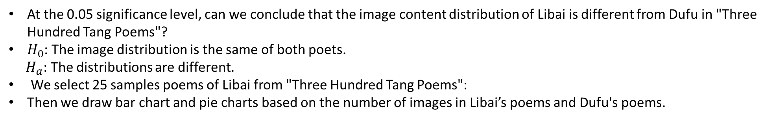
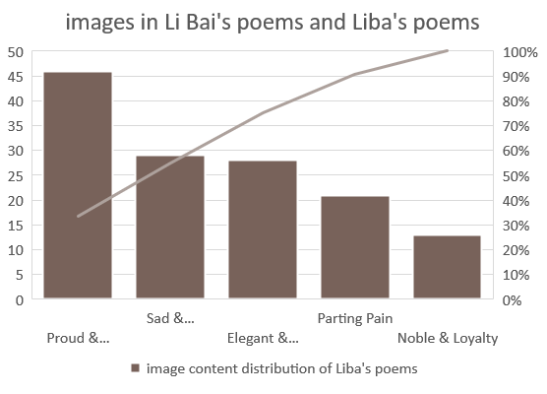
Result—Chi-square Goodness of Fit Test
At the 0.05 significance level, can we conclude that the image content distribution of Libai is different from Dufu in "Three Hundred Tang Poems"?
$H_{0}$: The image distribution is the same of both poets.
$H_{a}$: The distributions are different.
We select 25 samples poems of Libai from "Three Hundred Tang Poems":
Then we draw bar chart and pie charts based on the number of images in Libai’s poems and Dufu's poems.
Total = 46 + 29 + 13 +21 + 33 = 142

Slide 14
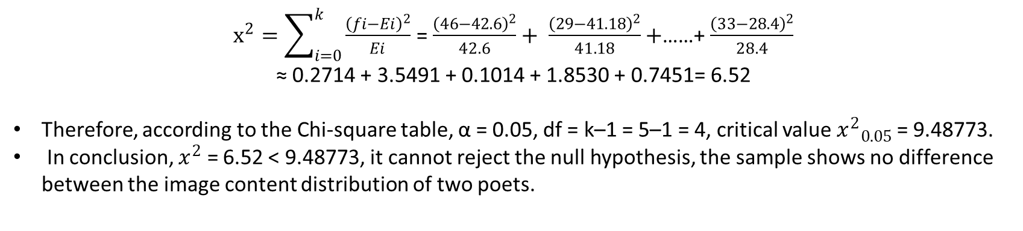
Result—Chi-square Goodness of Fit Test
We get the image content proportion distribution of Dufu.
Dufu:
Proud & Ambitious = 142 * 30% = 42.6
Sad & Melancholy = 142 * 29% = 41.18
Noble & Loyalty = 142 * 10% = 14.2
Parting Pain = 142 * 11% = 15.62
Elegant & leisurely = 142 * 20% = 28.4
 | Proud & Ambitious | Sad & Melancholy | Noble & Loyalty | Parting Pain | Elegant & leisurely
Libai | 46 | 29 | 13 | 21 | 33
Dufu | 42.6 | 41.18 | 14.2 | 15.62 | 28.4
$x^{2}=\sum_{i=0}^{k}{\frac{{\left(fi−Ei\right)}^{2}}{Ei}}$ = $\frac{{\left(46−42.6\right)}^{2}}{42.6}+ \frac{{\left(29−41.18\right)}^{2}}{41.18}+$……+ $\frac{{\left(33−28.4\right)}^{2}}{28.4}$
≈ 0.2714 + 3.5491 + 0.1014 + 1.8530 + 0.7451= 6.52
Therefore, according to the Chi-square table, α = 0.05, df = k–1 = 5–1 = 4, critical value ${x^{2}}_{0.05}$ = 9.48773.
In conclusion, $x^{2}$ = 6.52 < 9.48773, it cannot reject the null hypothesis, the sample shows no difference between the image content distribution of two poets.

Slide 15
Discussion
Interpret results around project goals
The goal of our project is to study the difference between the poems of Libai and Dufu in "Three Hundred Tang Poems. The length and the image of the two poems are compared, and the difference is not big.
Through the above two statistical methods: Hypothesis testing about two Population and Chi-square test, Our team members can get the result that Our team members do not have enough evidence to say that the length of Libai’s poems and Dufu’s poems are different and there is a difference between the distribution of the imagery of the two poets . The poets of the two poets have no difference in length and image.
Provide comments and improve experimental procedures
Because when Our team members counted Libai's poems and Dufu's poems, our group found that Libai had a poem with a length of 1114. This value is an obvious outlier.
The outliers in a batch of data are worth paying attention to. It is very dangerous to include the outliers in the calculation and analysis of the data without culling, which will have an adverse effect on the results. Paying attention to the occurrence of outliers and analyzing the causes of them often become an opportunity to find problems and improve decision-making.

Slide 16
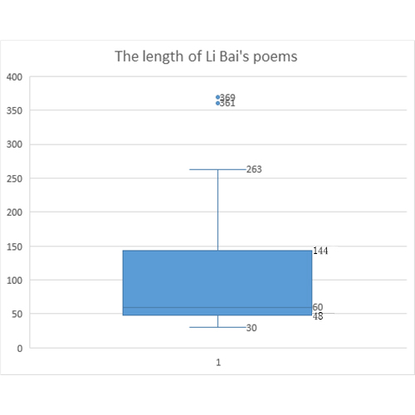
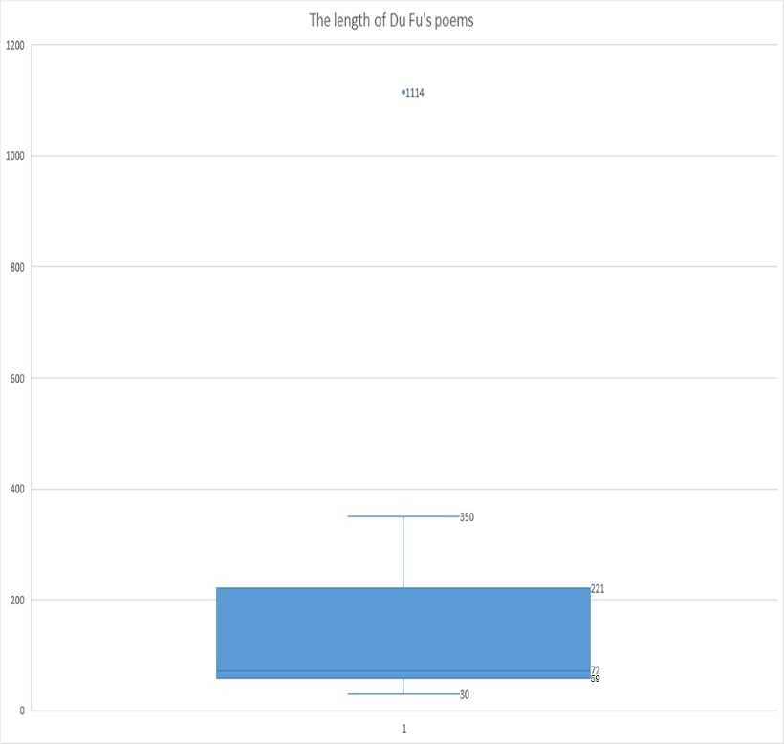
Discussion
The box plot provides us with a standard for identifying outliers: outliers are defined as values less than Q1-1.5IQR or greater than Q3 + 1.5IQR.
According to our further discussion and research. Our group use the "Descriptive Statistics: Numerical Methods" in Chapter 3 to draw "The Box-and-Whiskers Display" to show a set of data dispersion and determine outliers and their number.
1114
369
361

Slide 17
Discussion
Outliers:
According to our further discussion and research. Our group use the "Descriptive Statistics: Numerical Methods" in Chapter 3 to draw "The Box-and-Whiskers Display" to show a set of data dispersion and determine outliers and their number.
It is found from the picture that there are outliers in both poems.
There are two outliers in Libai's poems, which are 369 and 361, and one out of Dufu's poem is 1114.
The characteristics of the box chart:
a) Depends on the actual data, there is no need to assume that the data follows a specific distribution form, and there are no restrictive requirements on the data.
b) It is just a true and intuitive representation of the original appearance of the data shape, and the standard of the value is based on the quartile and quartile range. The quartile has a certain resistance.
Therefore, the results of identifying outliers in the box plot are more objective. This shows that the box plot has certain advantages in identifying outliers.
Suggestions
Therefore, in the study of the length of Libai's poems and Dufu's poems, our group can first calculate the outliers in the two sets of data, and consider whether to remove the outliers for calculation. Consider removing the outliers and drawing The Box-and-Whiskers Display again, and there are still extreme values.

Slide 18
04
Conclusion

Slide 19
Two methods
Two-sample hypothesis test
Test on the length of two great poet li bai and du fu's poetry
Collecting materials, numerical extraction, after calculation, statistics, etc.
Result: in the case of α= 0.05, there is not enough evidence to prove the started the first length of li bai and du fu's poems are different.
Chi-square goodness of fit test
In detecting image content distribution and li bai, du fu in the tang started for different use.
after data collection, image classification, image extraction, word frequency statistics, calculation, etc.
Concluding:α= 0.05, the two poets the conclusion of the image content distribution of no difference.

Slide 20
Value
Du fu and li bai were both representative poets of the tang dynasty. They stood on two peaks of poetry in the tang dynasty, one was called realism, the other was called romanticism.
Which of them is the wiser or the better can’t be said, because both of them are geniuses. To understand their differences in poetry, big data statistics are needed.
This time, the writing habits of the two poets were statistically analyzed and calculated in terms of the length and image of the poems, so as to obtain the data of their "writing preference", so as to better understand the writing habits of the two poets and their era.
Li bai represents the youth of the tang dynasty, while du fu represents the maturity of the tang dynasty.
In Yu qiuyu's Chinese context, it is mentioned that students at Peking University ranked their favorite poets, among which li bai was the first and du fu was the second.
In the eyes of most people, the length of poetry and the use of imagery are undoubtedly the two important factors affecting the choice, so this is the breakthrough of the two studies.
Surprisingly, according to the calculated data, the two great poets were almost identical in both respects.

Slide 21
Value
This strongly suggests that the factors that influence people's preference for these two poets are not the length of the poems or the use of imagery, but other factors.

Slide 22
Reference
Yu qiuyu, Chinese context, changjiang literature and art press, February 5, 2013.
2. Three hundred poems by Li Bai Tang:
http://www.shicimingju.com/shicimark/tangshisanbaishou_1_1__0.html
3. Three hundred poems by Du Fu Tang Dynasty:
http://www.shicimingju.com/shicimark/tangshisanbaishou_1_1__0.html

